Slide 1

PRESENTATION ON PROJECT
UNIVERSITY INSTITUTE OF TECHNOLOGY RGPV, BHOPAL(M.P.)
Customizable_Online_Resume
Presented By: Vivek Rai
Enroll. : 0101CA211069
MCA ^{3th} Semester

Slide 2
Content
About Project
Modules in Project
Software and Hardware specification
Designing
Data Flow Diagram
E-R Diagram
Implementation
Snapshots
Technologies Used
Conclusion

Slide 3
Introduction
A resume website, sometimes called a CV website, is a digital version of a traditional paper resume. Like the printed version, it is self-designed, but an online format adds an attractive presentation of your skills, a Biodata of your work and testimonials of your abilities.
A resume is a formal document that provides an overview of your professional qualifications, including your relevant work experience, skills, education, and notable accomplishments. Usually paired with cover letter a resume helps you demonstrate your abilities and convince employers you’re qualified and hireable.
The spelling of resume actually originates from French, and means “summary.” To this day, the purpose of a resume is still to provide employers with a summary of your relevant qualifications.
If you’re applying for a job, you need at least a resume to be considered for the position.

Slide 4
Modules
REGISTER MODULE
Username
Password
Email
Contact number
address
LOGIN MODULE
Username
Password

Slide 5
Software and Hardware Specification
Hardware specification
INTEL I5 with NVIDIA Graphics
At least 8 GB RAM
Software specification
JAVA, JDK 1.8 , Visual Studio Code
Operating System Window 10 and above
Web browser ( Chrome, I.E 8 and above, Firefox, Safari etc.)

Slide 6
OBJECTIVE AND PURPOSE
A resume website gives you more room for self-expression.
2. A personal resume website is hard evidence of your computer skills.
3. A web resume is a great place for displaying your skills.
4. A website resume is a perfect place for references and testimonials.

Slide 7
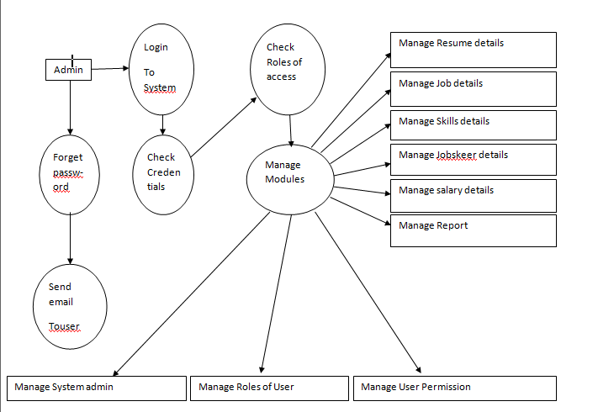
Data Flow Diagram

Slide 8
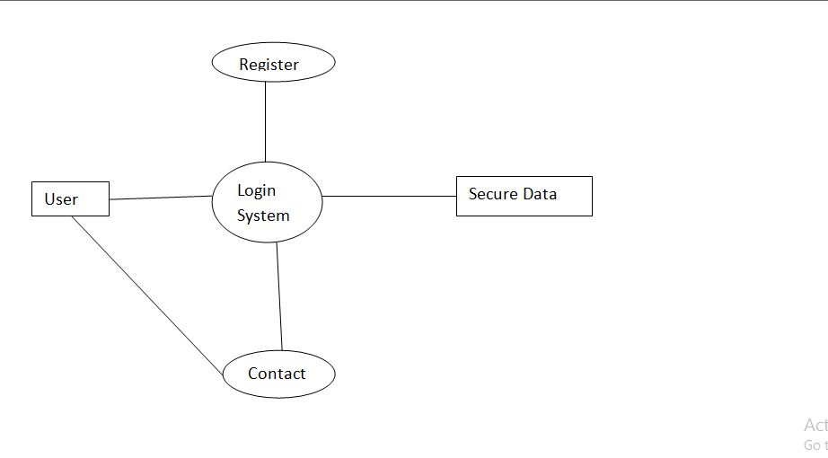
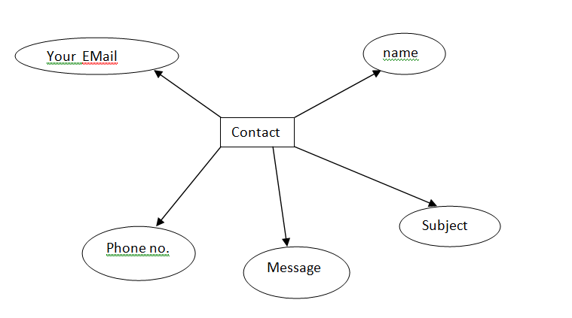
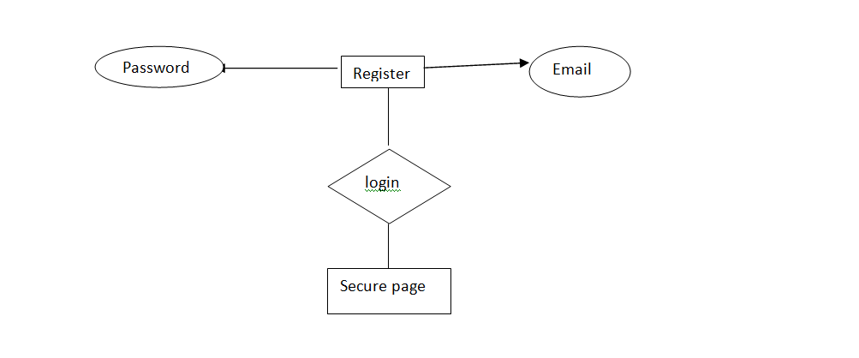
E-R DIAGRAM

Slide 9
SCREENSHOTS
User Views

Slide 10
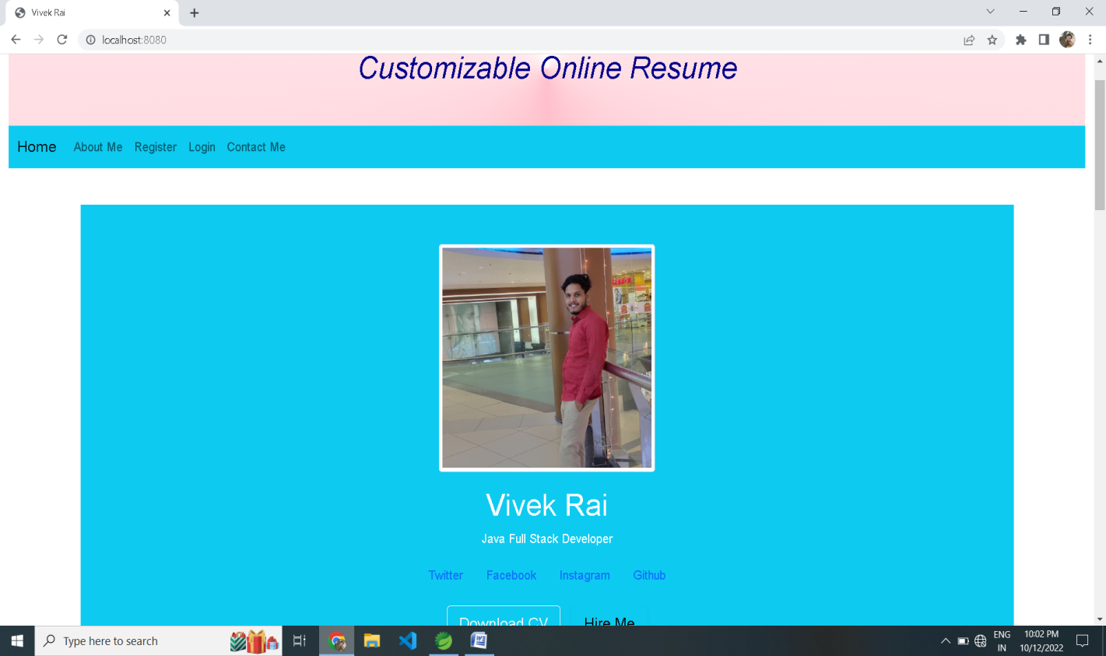
Input / Output Screen

Slide 11
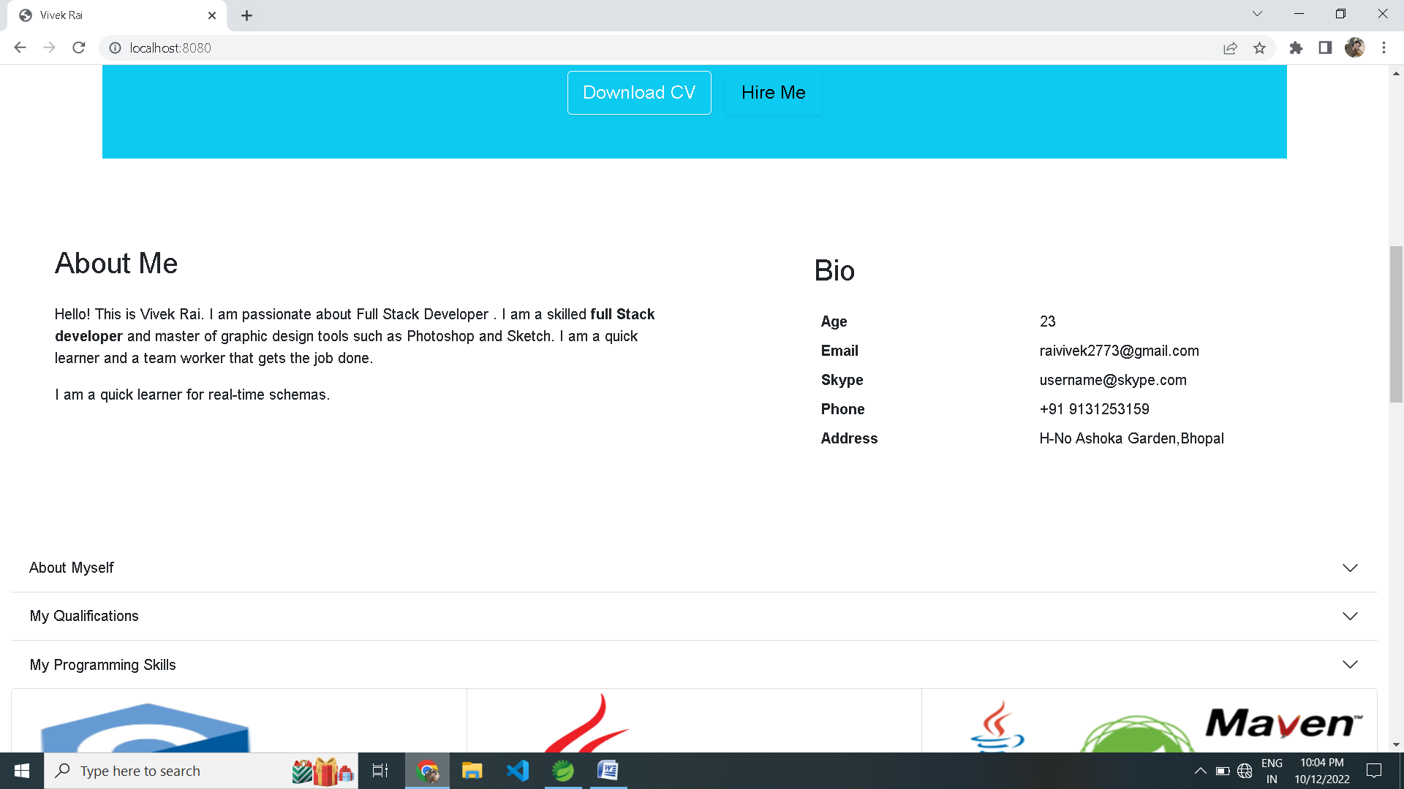

Slide 12
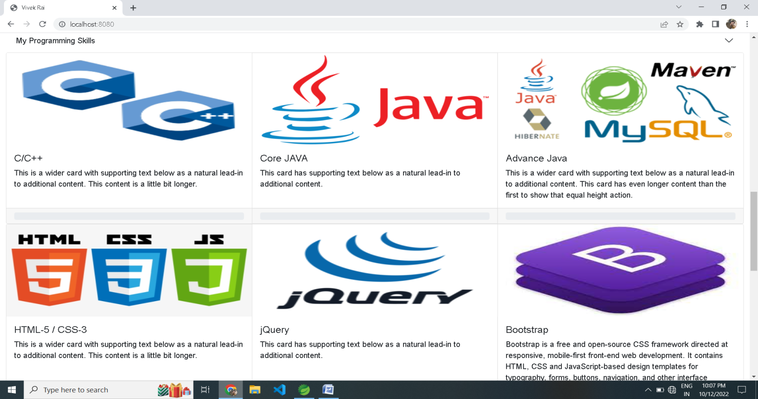

Slide 13
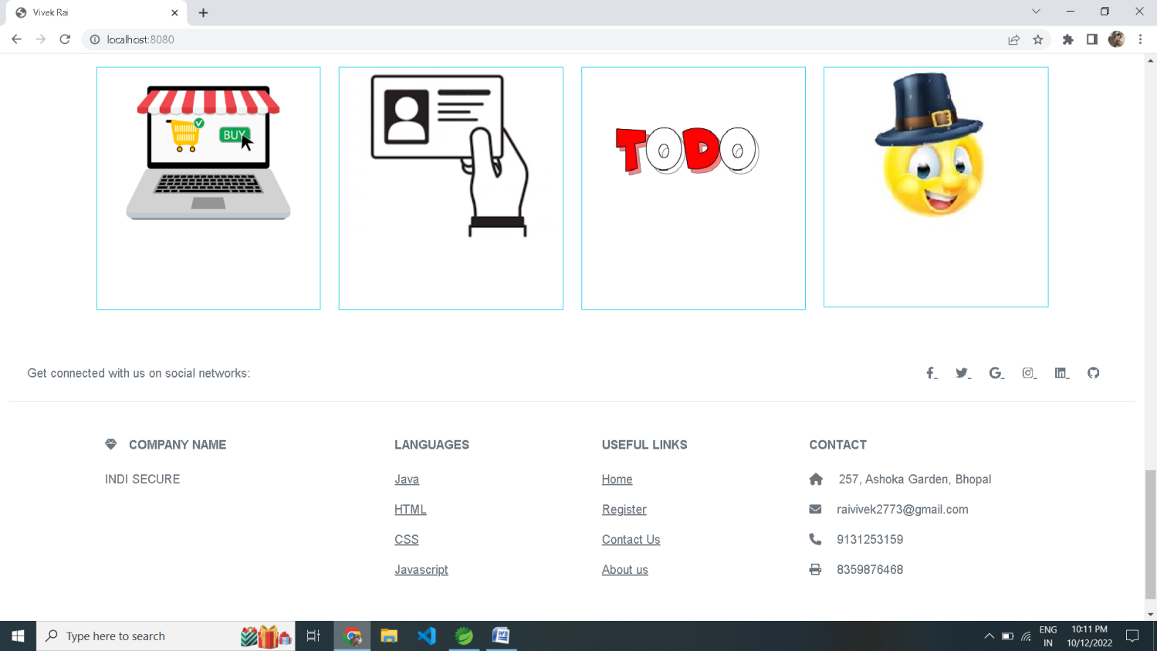

Slide 14
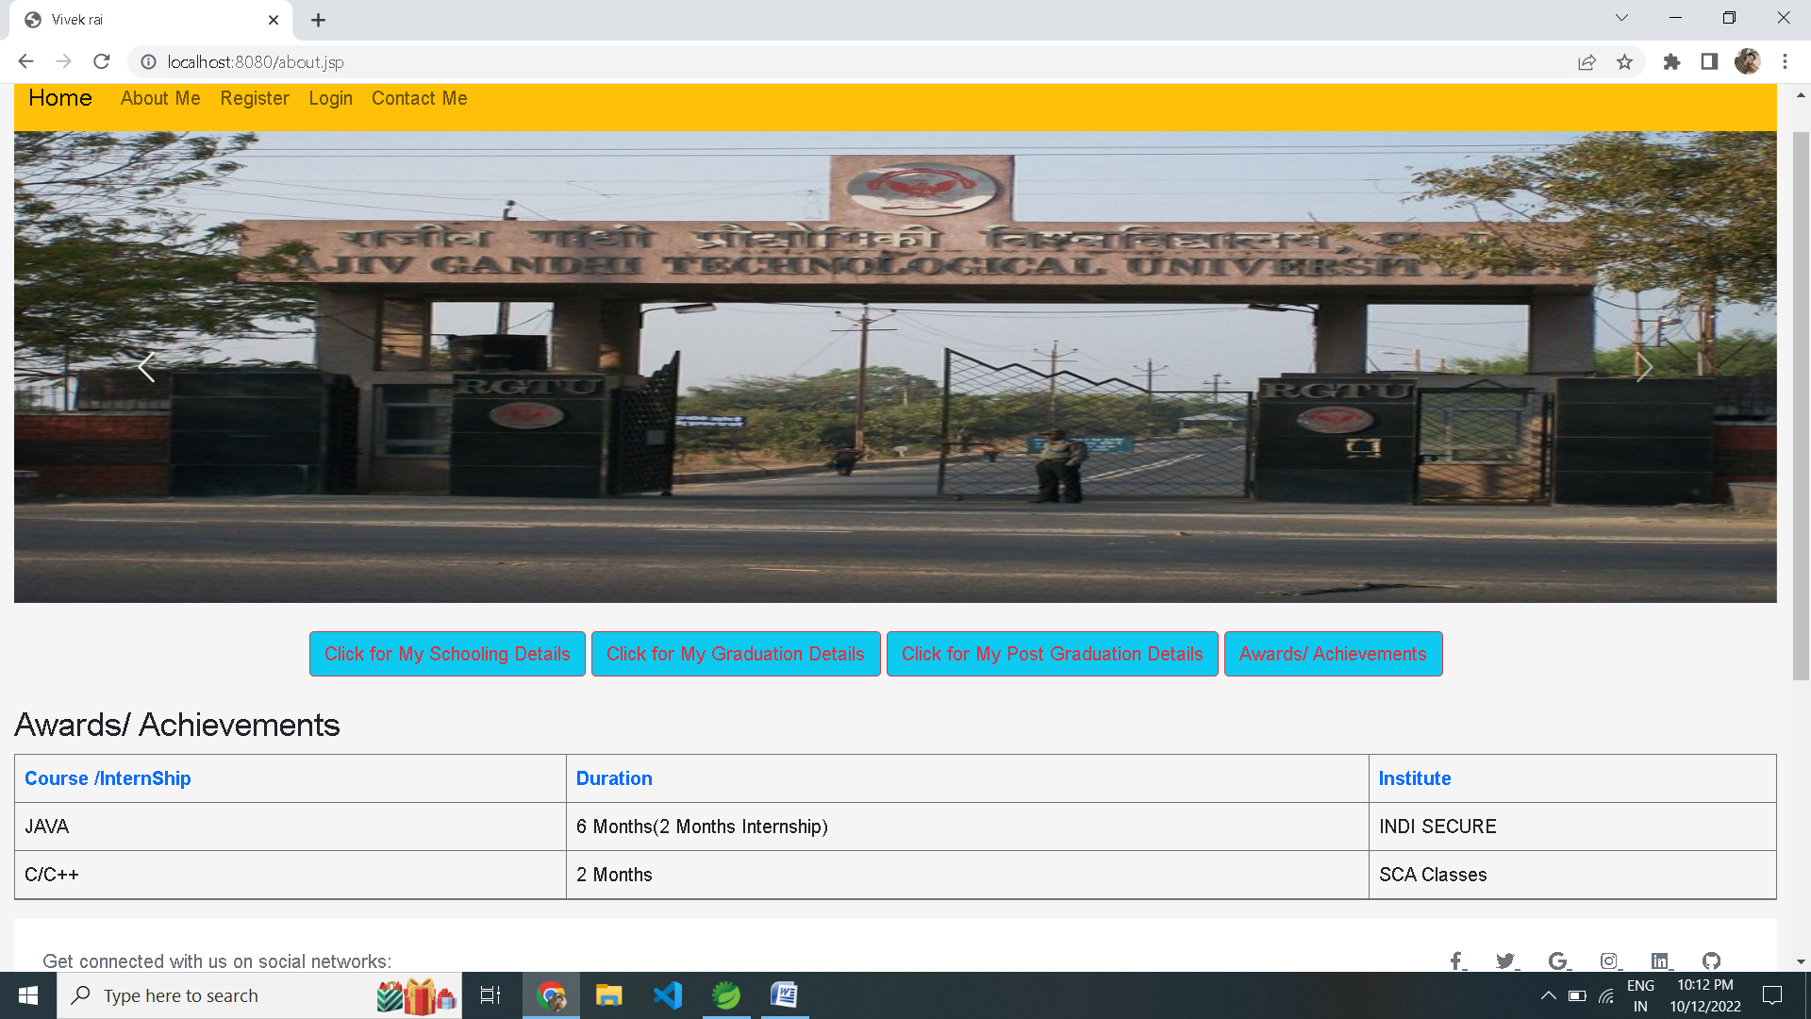

Slide 15
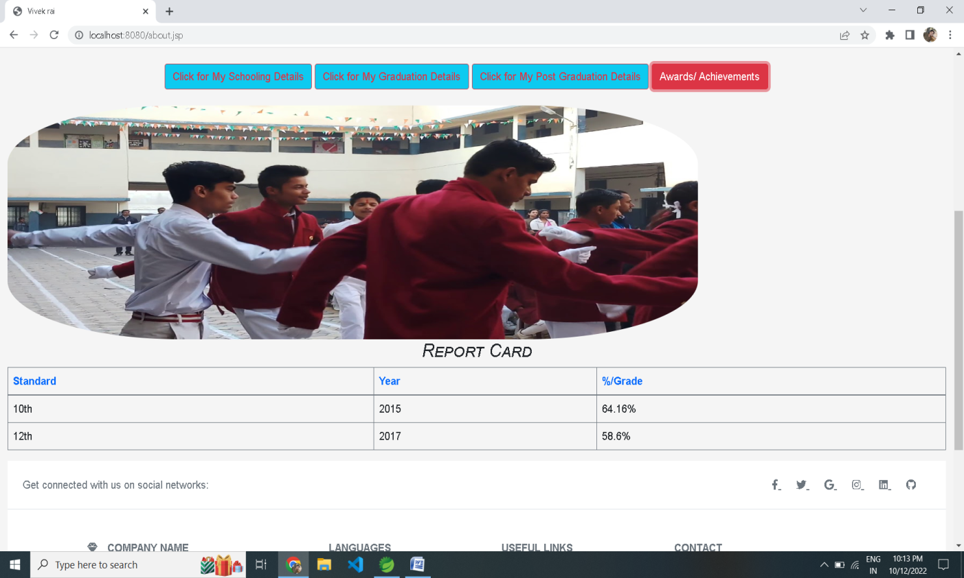

Slide 16
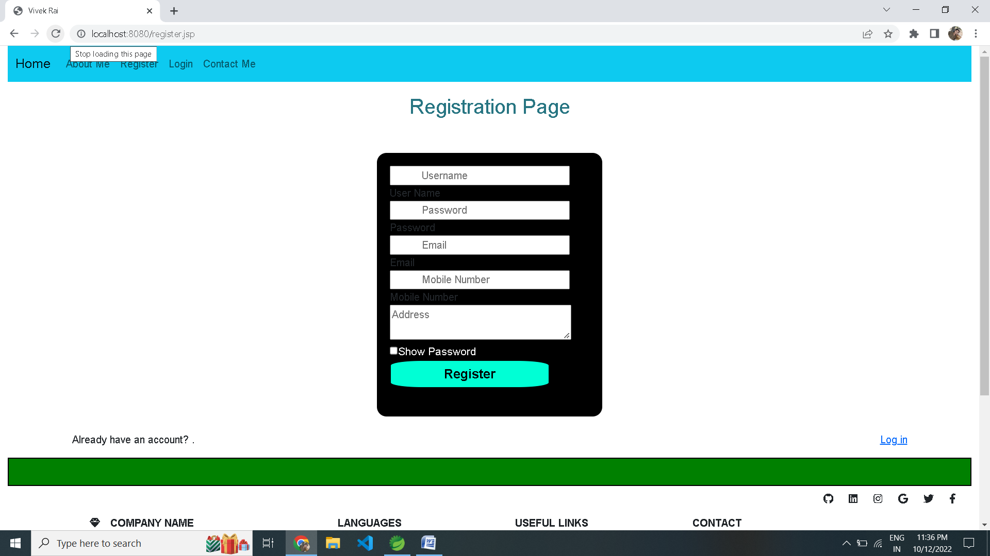

Slide 17
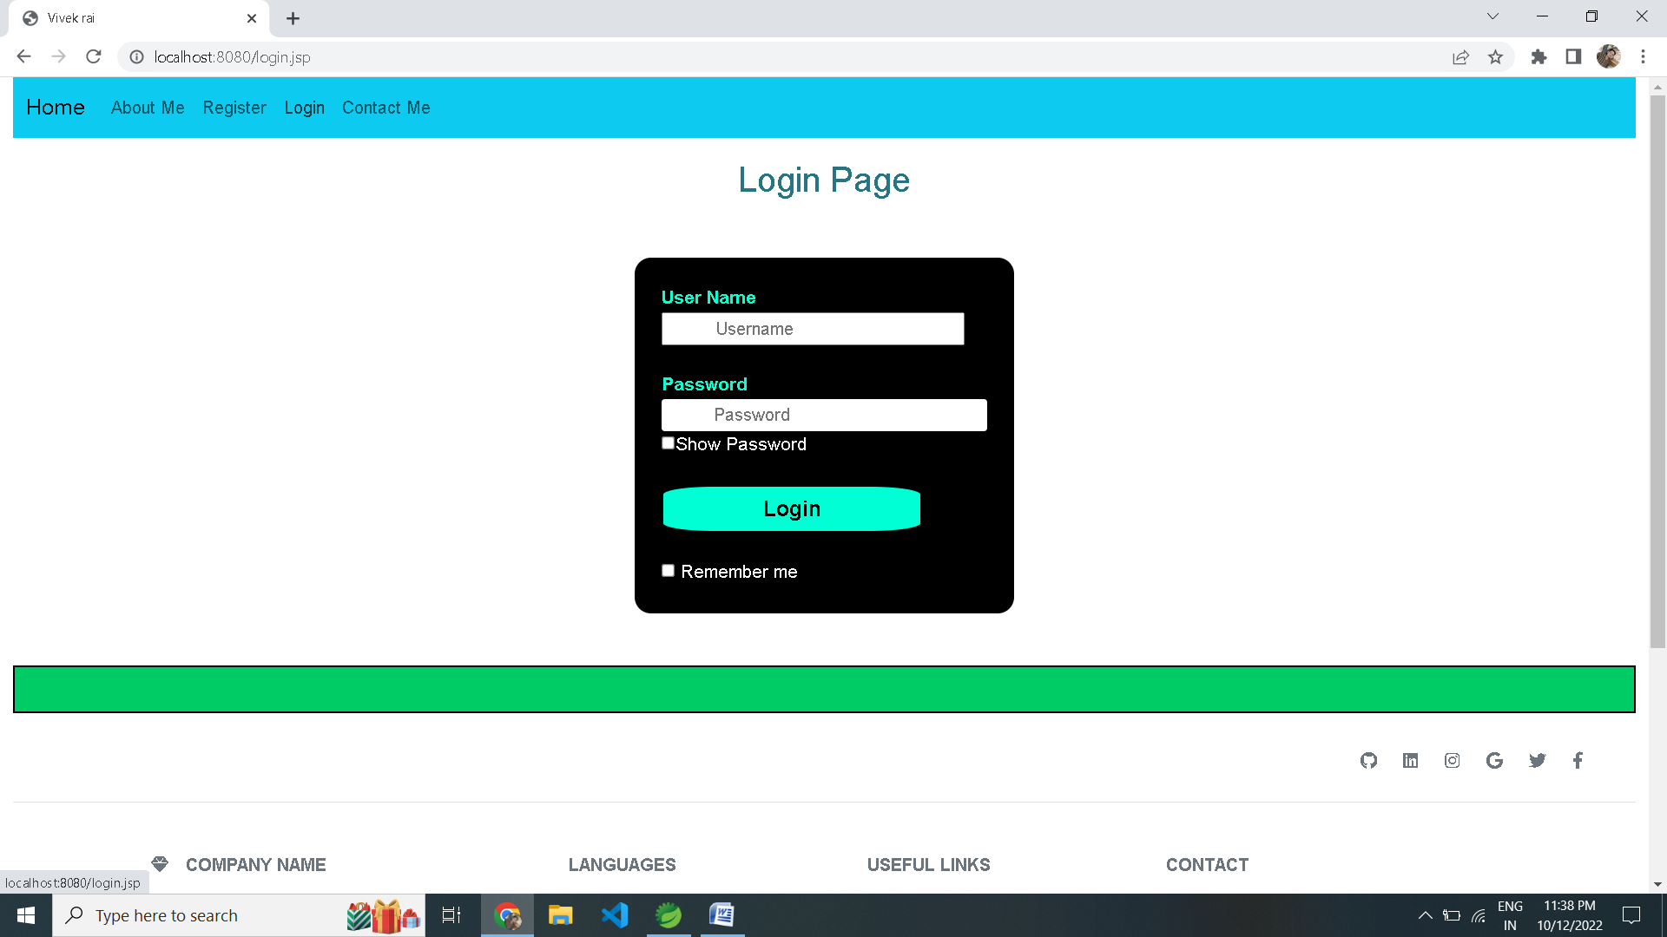

Slide 18
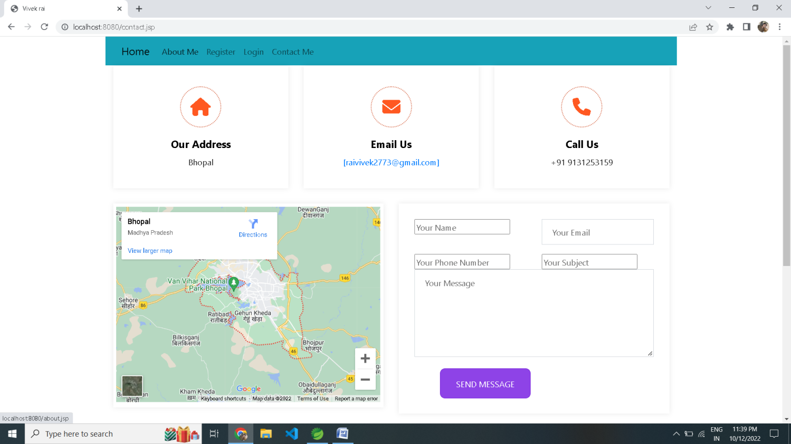

Slide 19
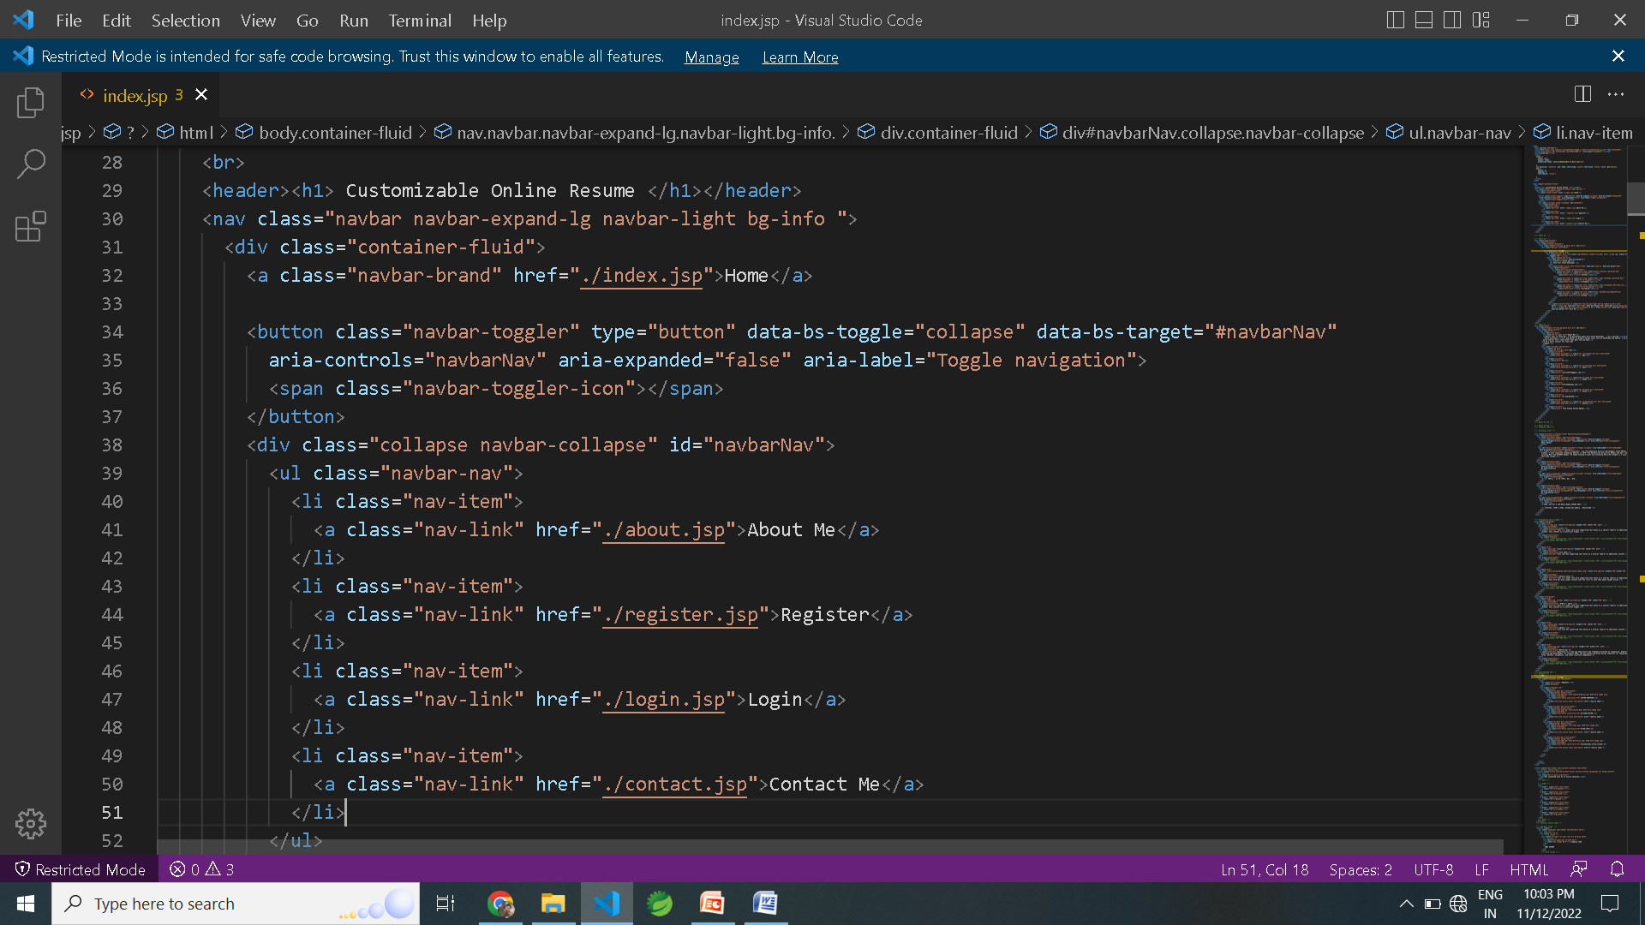
INDEX

Slide 20
TECHNOLOGY USED
Server-side tools and technologies used
Spring Boot
Spring Data JPA(Hibernate)
Maven
Embedded Tomcat
MYSQL Database
JDK1.8
Client-side tools and technologies used
Vscode
Bootstrap5
Java Script
jquery

Slide 21
CONCLUSION
The new form of Resume is made in the style to show your Resume on the new look, here is the form of profile of social media Facebook, Instagram. Based on the same, it has been told in a new form.
With the increasing expansion of technology, resumes and resumes also want to be seen as a website. Paper Resume, Resume in PDF can be roaming anywhere. There can be many problems. Along with this website profile, many new features have also been added. Can email you directly, visit your social media and see you. Reliable information can be found. Further, you can add the option of online chat and our personal information in this

Slide 22
THANK YOU

